Slide 4
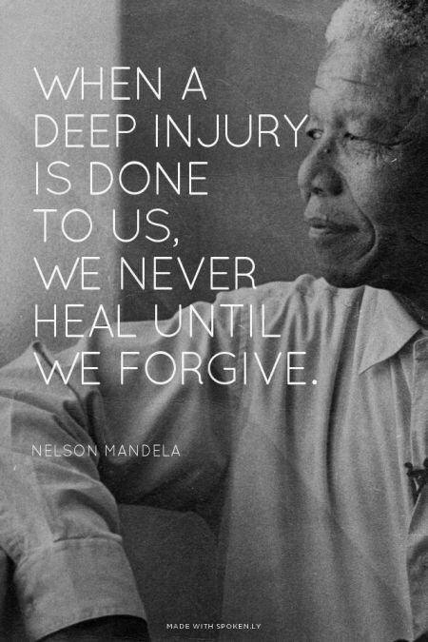

Slide 5
Matthew 18:21-35
Mat 18:21 Then Peter came up and said to him, "Lord, how often will my brother sin against me, and I forgive him? As many as seven times?"
Mat 18:22 Jesus said to him, "I do not say to you seven times, but seventy times seven.
Mat 18:23 "Therefore the kingdom of heaven may be compared to a king who wished to settle accounts with his servants.
Mat 18:24 When he began to settle, one was brought to him who owed him ten thousand talents.
Mat 18:25 And since he could not pay, his master ordered him to be sold, with his wife and children and all that he had, and payment to be made.
Mat 18:26 So the servant fell on his knees, imploring him, 'Have patience with me, and I will pay you everything.'
Mat 18:27 And out of pity for him, the master of that servant released him and forgave him the debt.

Slide 6
Mat 18:28 But when that same servant went out, he found one of his fellow servants who owed him a hundred denarii, and seizing him, he began to choke him, saying, 'Pay what you owe.'
Mat 18:29 So his fellow servant fell down and pleaded with him, 'Have patience with me, and I will pay you.'
Mat 18:30 He refused and went and put him in prison until he should pay the debt.
Mat 18:31 When his fellow servants saw what had taken place, they were greatly distressed, and they went and reported to their master all that had taken place.
Mat 18:32 Then his master summoned him and said to him, 'You wicked servant! I forgave you all that debt because you pleaded with me.
Mat 18:33 And should not you have had mercy on your fellow servant, as I had mercy on you?'
Mat 18:34 And in anger his master delivered him to the jailers, until he should pay all his debt.
Mat 18:35 So also my heavenly Father will do to every one of you, if you do not forgive your brother from your heart."

