Slide 1
Types of Leadership
A look at models and styles of leadership

Slide 2
Module 1: Foundations of leadership
Gain an understanding of leadership / what it means to be a leader.
Module 2: Fundamentals of leadership
Prepare for leadership.
Module 3: Growing in leadership
Learn how to be effective in various leadership contexts.
Module 4: Advanced leadership
Learn how to handle complex contexts requiring more finesse / skill.

Slide 3
Module 1: Foundations of leadership
1. Types of leadership (Why lead?)
2. The tasks of a leader (What does a leader do?)
3. The tests of a leader (What will you face as a leader?)
4. The traits of a leader (What do you need to be a leader?)
5. The trophies of a leader (The honour of leadership)
Last Sunday of each month July to November 13h00 to 14h30 @ TCC

Slide 4
Lesson 1: Types of Leadership
Introduction
Why lead?

Slide 5
Types of Leadership
Failures of leadership
Abdicated Leadership
Illegitimate Leadership
Abuses in Leadership
Autocratic Leadership
Democratic Leadership
Rejection of Leadership
Anarchy
Biblical Leadership
Servant Leadership

Slide 6
Abdicated Leadership
There are many real-life cases of abdication
Biblical examples include
Adam who allowed Eve to lead him
Ahab whose passivity produced Jezebel
Saul
Hid amongst the baggage.
Insecurity is one of the greatest character problems for a leader.
Sat around when it was time for action
Passivity is a huge problem – most often of men (why?)

Slide 7
Illegitimate Leadership
Leadership may be illegitimate
Through self-appointment
Through crossing boundaries of authority
Saul and Samuel
Saul made illegitimate sacrifices
Fear of man. Need for respect. People-pleasing rather than God honouring.
Through premature appointment
Joseph pushed too hard
David waited

Slide 8
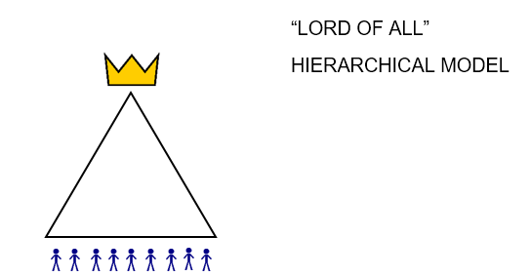
Autocratic Leadership
This kind of leadership is also known as “Lord of All”. The model is one of autocratic rule often supported by an elaborate hierarchy.

Slide 9
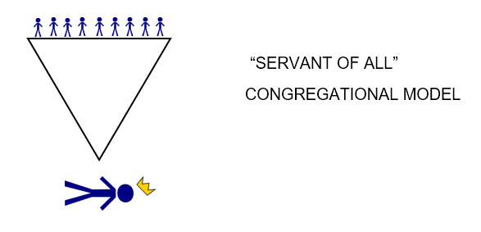
Democratic Leadership
This kind of leadership is also known as “servant-of-all”. The people exercise rule by voting leaders in and out of office. The leader must serve the demands of the people, or risk being removed.

Slide 10
Anarchy
Aka “No Lord at all”
Fuelled by hurt
Rejection of authority
Discarding Leadership
Examples
Some Discipleship movements
Some “House church” movements
Orphan-spirited believers
The answer to abuse is not non-use but correct use

Slide 11
Servant Leadership
The closest to an ideal is a leader “in front”. A leader who is seen to be leading. Not token leadership or a figurehead exercising only positional authority, but one who works and serves, actively setting an example. The description is Servant-King.

Slide 12
Questions
What kind of leader is God, the Father?
What kind of leadership did Jesus demonstrate in his incarnation?
What type of leader are you / would you tend to be based on your personality?
List three character weaknesses you see in yourself.
What effect do you think the above areas of weakness have on your readiness for promotion?

